Slide 1
Industry Practice
Training cum Intern @ Brimma Tech
Kanthimathi I

Slide 2

About Brimma Tech
Mission
deliver automation innovations
Vision
premier partner to a growing list of mortgage lenders
Stated at
2016
MORTGAGE PROCESS OPTIMIZATION
TECHNOLOGY/ ARCHITECTURE ENABLERS ANALYSIS
AGILE DELIVERY CENTER OF EXCELLENCE

Slide 3
Work & Role
Front End Technologies Database
Back End Technologies
Full Stack Development
Role: Intern Trainee

Slide 4
Timeline
Technologies & Concepts with Time Period
HTML, CSS & | JS & MYSQL | MYSQL, & CORE | CORE JAVA | ANGULAR | PROJECT | INTERN
BOOTSTRAP |  | JAVA
Assessments on Web Basic
JS Validations & Data Base Basics
Core concepts in Java
Java with OOPS concepts
Angular Basic
Bidding Website for Agricultural Products
.NET and C#
Aug- Sep '22
Oct '22
Nov - Dec '22
Jan '23
Feb '23
Mar '23
Apr '23 - present

Slide 5
Project - Problem Statement
The problem statement to develop the given use case
Bidding Portal – Website for bidding between Farmers and Consumers A portal where farmers can upload the data of grains/veggies/fruits produced along with the quantity, images, etc. and consumers can directly bid with the farmers.

Slide 6
Bidding Website for Agricultural Products
Administration
4
ADMIN
Access rights
Access rights
2
1
2
Login As Farmer (Seller)
Register
Login As Bidder (Buyer)
3
3
Profile
Framer's Details
Profile
History of bidding
Add Product Details
Crop Full Info for bidding
Bidding Options
All the details of bidding products
Monitor Biddings
Accept / Reject the bidding
My Cart
Bidded products

Slide 7

Requirements
Tools and Technologies that are required for the product
Front End: Angular Framework
Back End: node.js
DB Storage: MySQL

Slide 8

Modules
Different modules that performs various functionalities
Admin Module User Modules:
Consumer Farmer

Slide 9


Modules Functionalities
Roles and Functionalites performed by different users
ADMIN
Give full access rights to all the users (Consumers/Farmers) Accept / Reject the user login Control of all the products.
Maintenance of website
FARMER
Get approval from Admin Add products for the bidding Final decision for the product bidding.
Set the time limit
CONSUMER
Get approval from Admin View all products for the bidding
Bids for the product(Higher to the current rate).
View all the history of bidding.

Slide 10
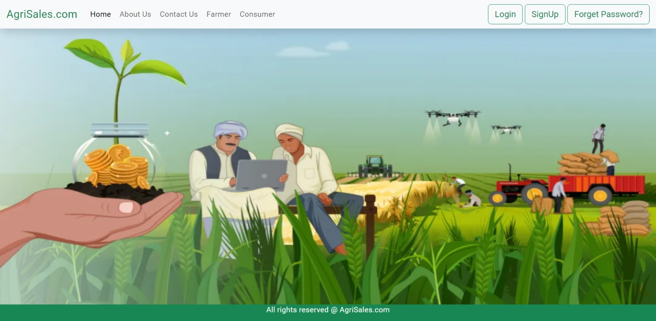
Home Page

Slide 11
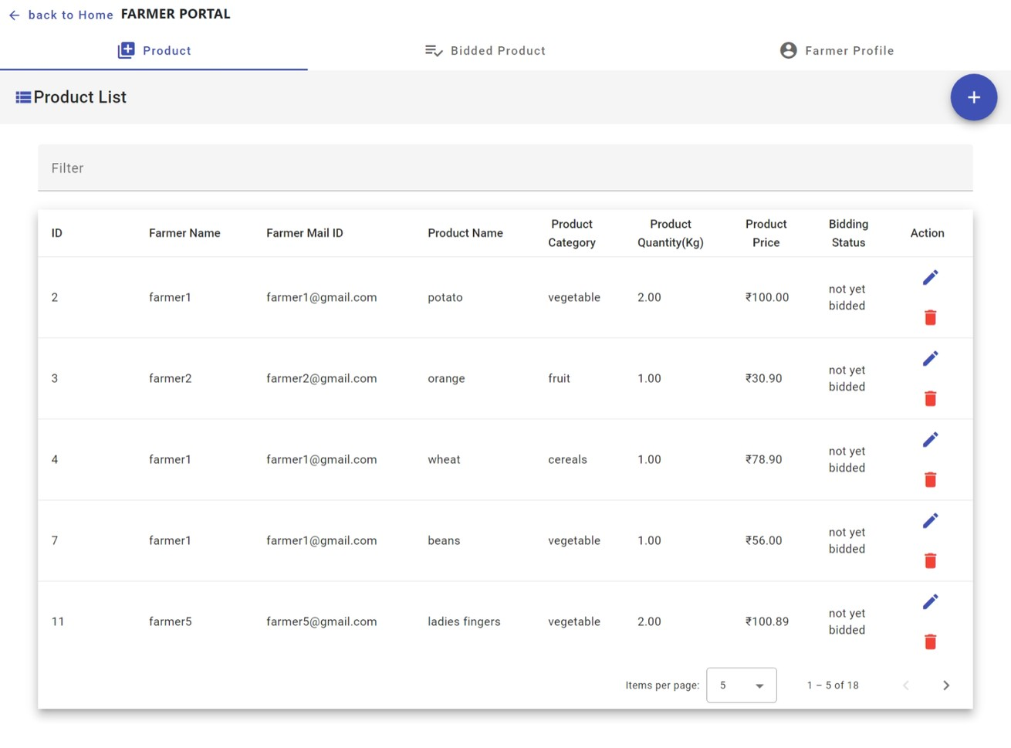
Farmer Portal - Product List

Slide 12
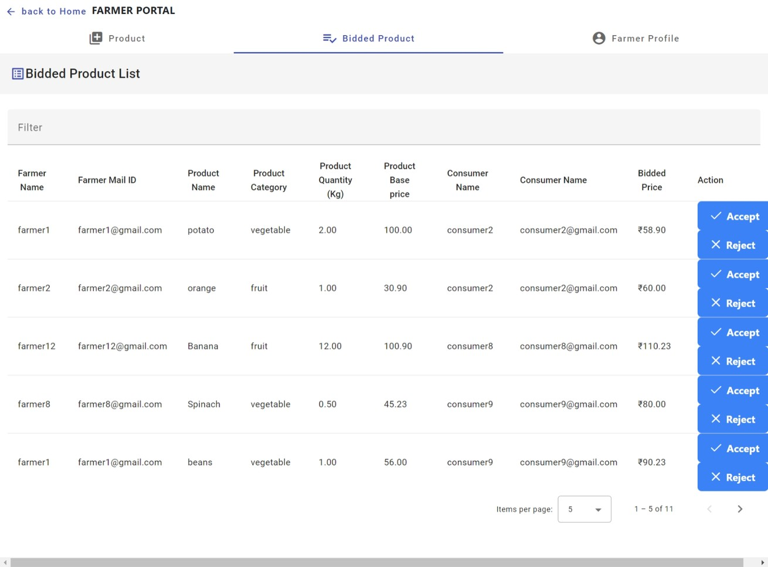
Farmer Portal - Bided Product

Slide 13
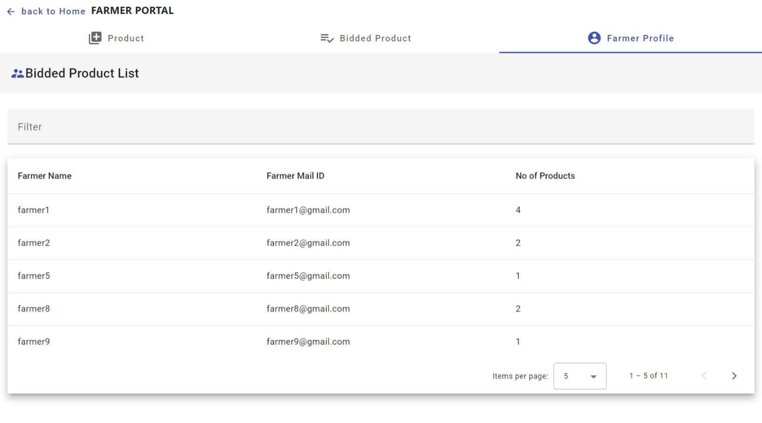
Farmer Portal - Farmer's Profile

Slide 14
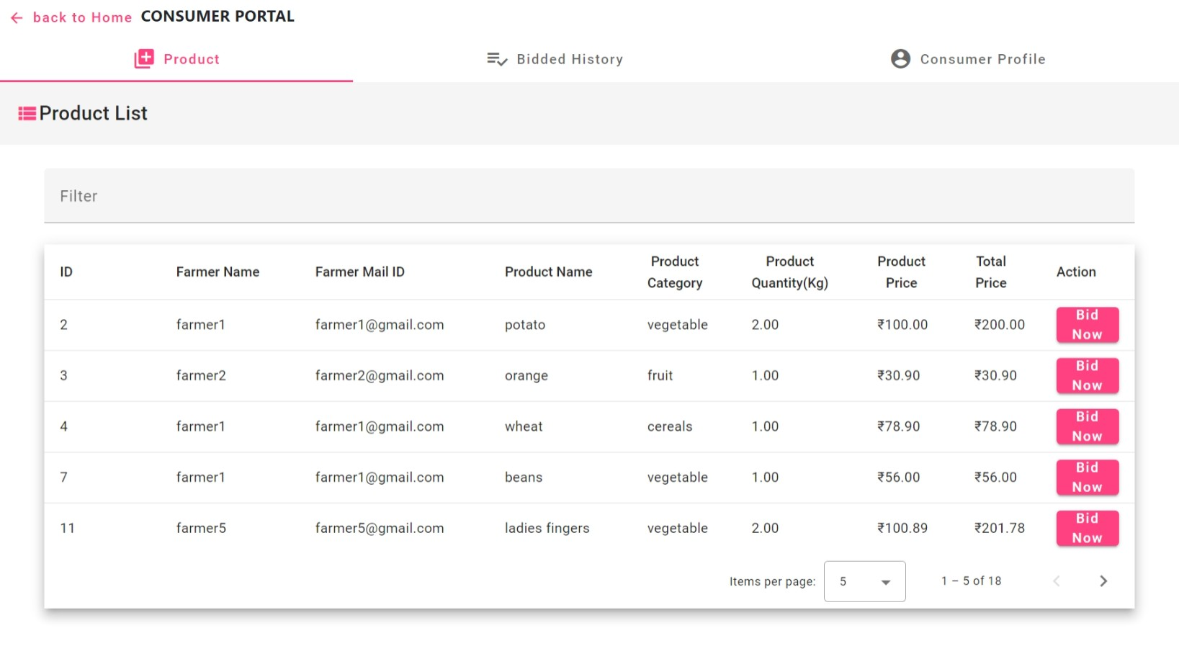
Consumer Portal - Product List

Slide 15
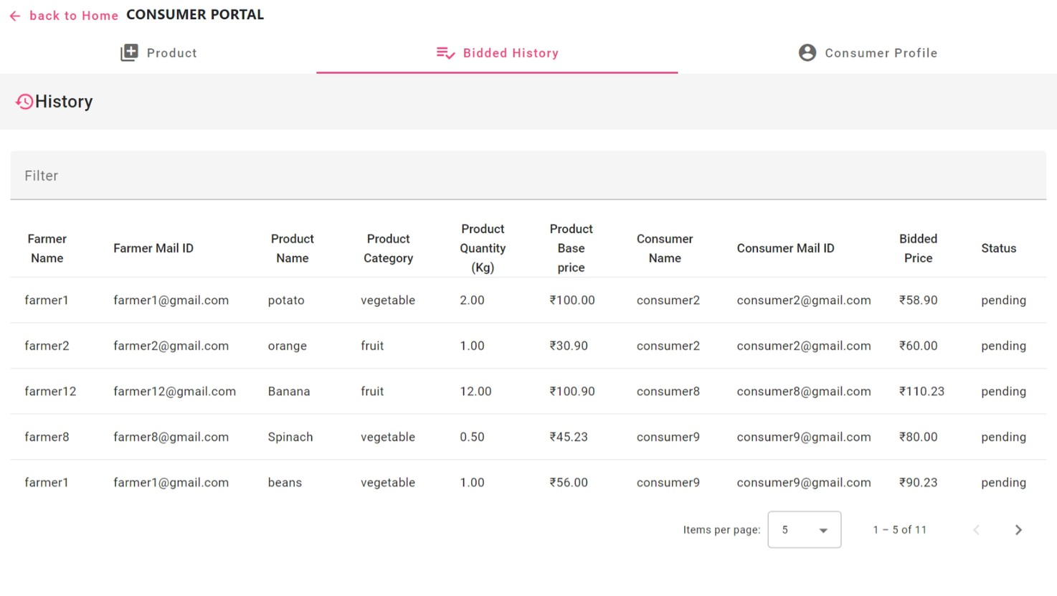
Consumer Portal - Bided History

Slide 16
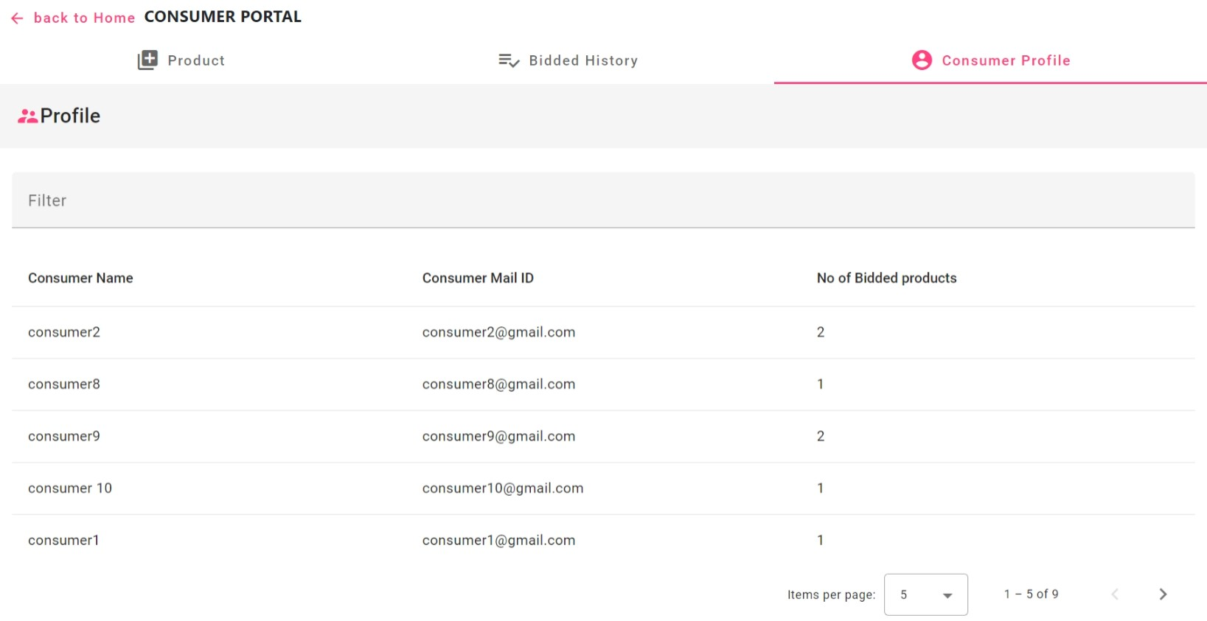
Consumer Portal - Consumer's Profile

Slide 17


